Slide 1
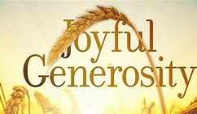
s

Slide 2
Slide 1
Generosity is often a natural outgrowth of compassion.
The line between the two can be hard to distinguish.
We don’t need to wait until the feelings of compassion arise before we choose to be generous.
Generosity is often something that we learn to enjoy by doing.

Slide 3
Slide 2
“Self-Forgetfulness”
It is in giving that we receive, and the opposite is true as well, ‘when we are most self-focused , we tend to be miserable’.

Slide 4
Slide 3
Generosity is important for survival.
The reward centers of our brain light up as strongly when we give as when we receive, sometimes even more so.
Generosity is associated with better health and longer life expectancy.
Money can buy happiness, if we spend it on other people, as research indicates.

Slide 5
Slide 4
Not just about money
Giving of our time is just as important as the money we give.
Generosity leads to a sense of purpose.
Purpose is about how we contribute and how we are generous to others; how we feel needed by and of value to others.

Slide 6
Slide 5
Generosity leads to meaning
Compassion and generosity are at the center of our humanity. It’s what makes our lives joyful and meaningful.
The Archbishop also states that we are fundamentally good. The aberration is not the good person; the aberration is the bad person. We are made for goodness.

Slide 7
Slide 6
The problems that we are facing today are very difficult to solve.
Both religious and secular education are needed.
We need to educate children about the value of compassion and the value of applying our minds to solve the worlds difficult problems.
Do what you can to help solve the worlds problems.
Give the world your love, your service, your healing, but you can also give it your joy. This, too, is a great gift.

Slide 8
Slide 7
Generosity of Spirit
This is the quality that both the Dalai Lama and Archbishop Tutu both have, perhaps more than any other.
Giving of our wisdom, moral and ethical teachings.
It means being big-hearted, magnanimous, tolerant, broad-minded, patient, forgiving and kind.
Also described as becoming an oasis of peace, a pool of serenity that ripples out to all of those around us.
When we practice generosity of the spirit, we are in many ways practicing all the other pillars of joy.

Slide 9
Slide 8
Generous people give out of their substance, whether large or small.
This is illustrated in the Gospel of Luke 21: 1-4
Jesus compares the widows mite to the rich man’s gifts – demonstrating that the gifts of all are needed and used in God’s economy.
Jesus said “Truly, I tell you, this poor widow has put in more than all of them. For they all contributed of their abundance, but she out of her poverty put in all she had to live on.”

Slide 10
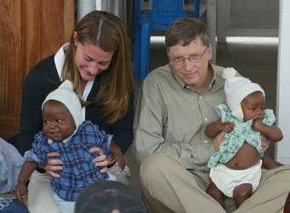
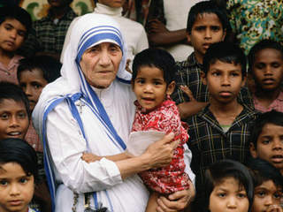

Slide 12
Generosity Practices
Material Giving: There is no substitute for helping to lessen the inequality and injustice that are such enduring features of our world.
Giving freedom from fear: This can involve giving protection, counsel, or solace. This is how we can give our time and attention to others.
Spiritual Giving: You don’t have to be a holy man or a spiritual teacher to give in this way. Spiritual giving can involve giving wisdom and teachings to those who may need them, but it can also involve helping others to be more joyful through the generosity of your own spirit.

Slide 13
DISCUSSION
What does generosity mean to you?

